Slide 1
CAR 163916470 (Finding)

Slide 2
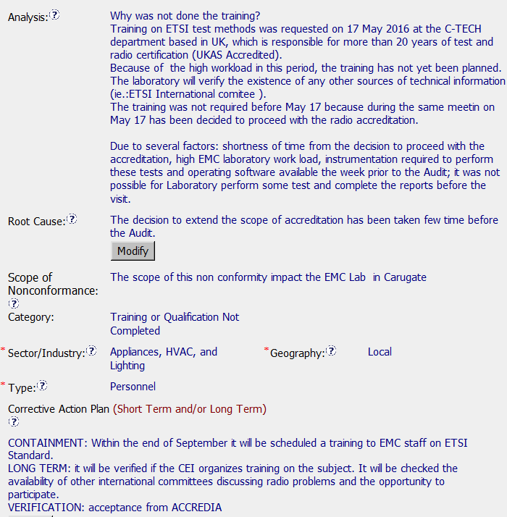
CAR 163916470
Stakeholders were not identified
Why did this not happen in time?
Still need verification by CAR Owner

Slide 3
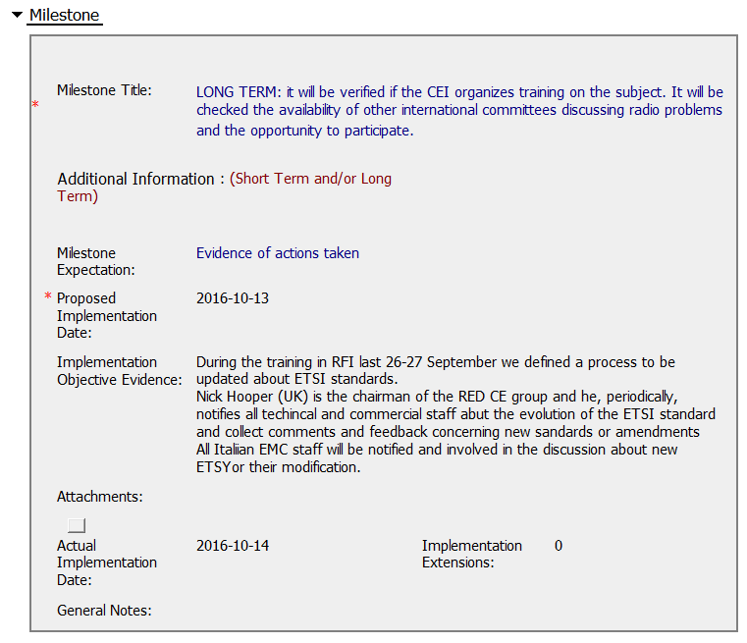
CAR 163916470
Could provide more guidance on objective evidence needed
CAR completed in timely manor; no escalations or extensions

Slide 4
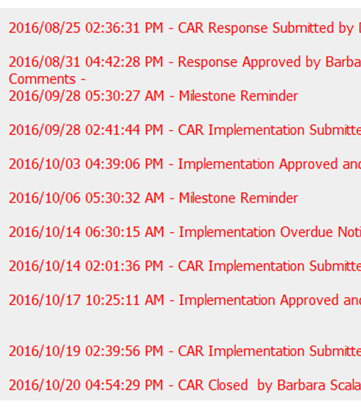
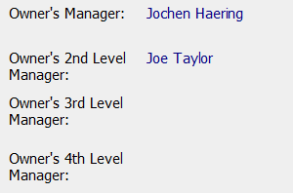
CAR 163916470
CAR Admin responded promptly
Removed executives from escalation path

Slide 5
CAR 163916470
CBS Requirements | Excellent | Moderate | Need Improve | N/A
(C) Extensions are within requirement (<30 days, 3 or less) |  |  |  | √
(T) Most appropriate ‘category’, ‘type’, ‘geography’ are selected | √
(P) Facilitates the handling of disputed CARs |  |  |  | √
(T) Acts on CARs within required timeframe | √
(C) Analysis shows clear path to root cause and scope; stakeholders identified |  |  | √
(C) Root cause statement is succinct, reasonable, complete |  |  | √
(C) Corrective actions fix the objective evidence and other problems found; address entire root cause and scope. For observations, they do not go beyond fixing the objective evidence |  | √
(C) Milestones address containment & owner’s verification; completed per milestone expectations |  | √
(P) Verification per requirements |  |  | √
(L) Referenced communications are attached as needed |  |  |  | √
(C L) Evidence of communication for overdue/escalated CARs and other pertinent concerns |  |  |  | √
(P) Trains other CAR Champions |  |  |  | √

Slide 6
CAR 163916470 Finding

Slide 7
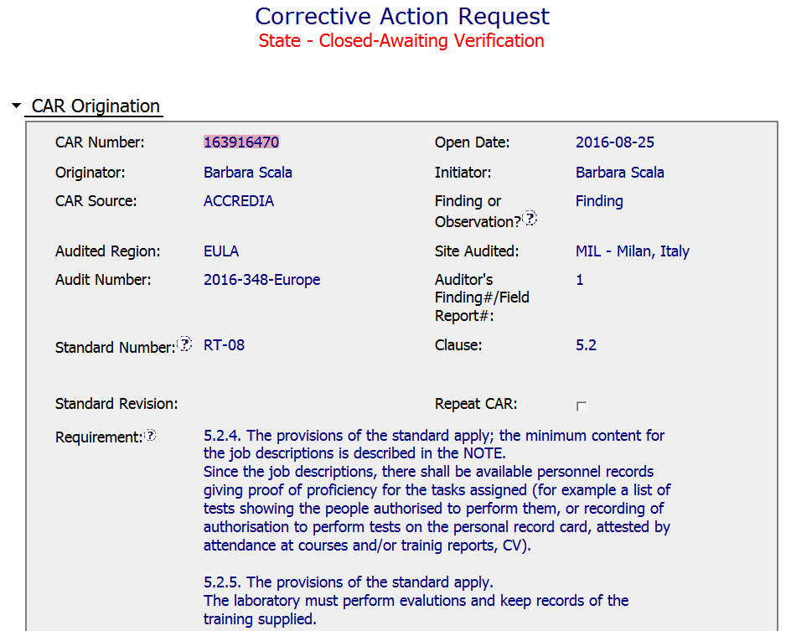
CAR 163916470
This is a Finding Accreditation CAR

Slide 8
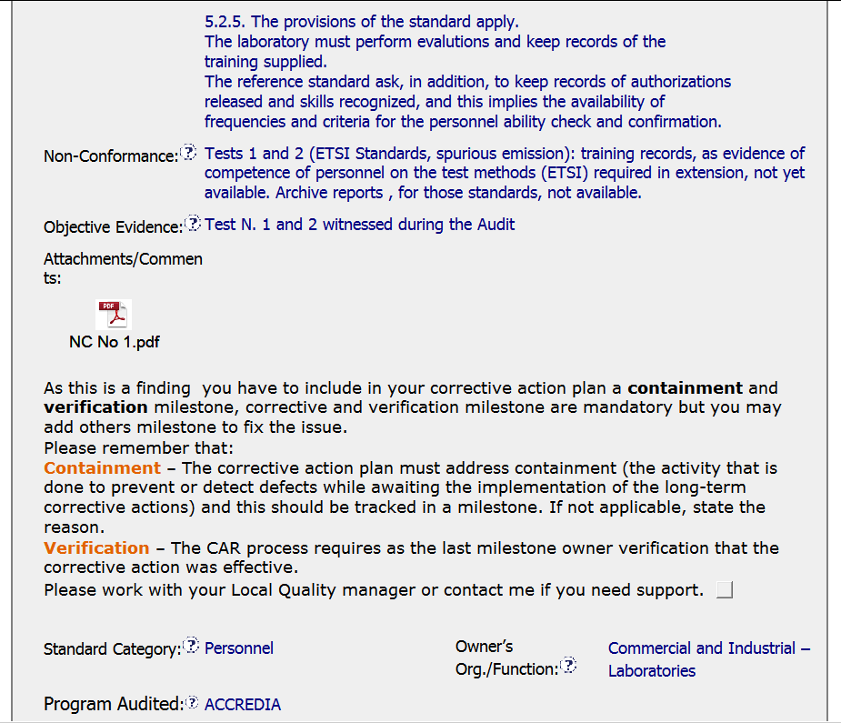
CAR 163916470
It is also important for CAR Originator to translate the nonconformity and objective evidence as stated in the audit report into English.
It is good for CAR Champion to add the important remarks to remind the CAR Owner at the very beginning about the expectation of the Finding CAR handling.

Slide 9
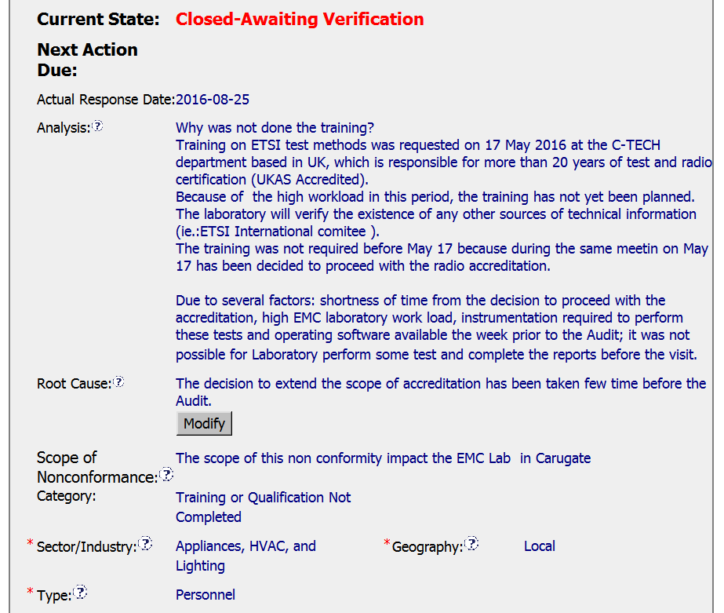
CAR 163916470
The Analysis cannot systematically illustrate the reason of why training of personnel cannot be undertaken prior to the accreditation audit.
Highly suggest to utilizing 5-WHYs’ approach to drill down the root cause, and remove other irrelevant paragraphs, e.g. heavy workload, unavailability of test instruments and softwares, etc.
In the Analysis part, it is advisable to illustrate more the background and rationale of why the scope of nonconformance is limited in Carugate EMC Lab only? e.g. Whether or not it is the only lab location applying this test item accreditation via Accredia?

Slide 10
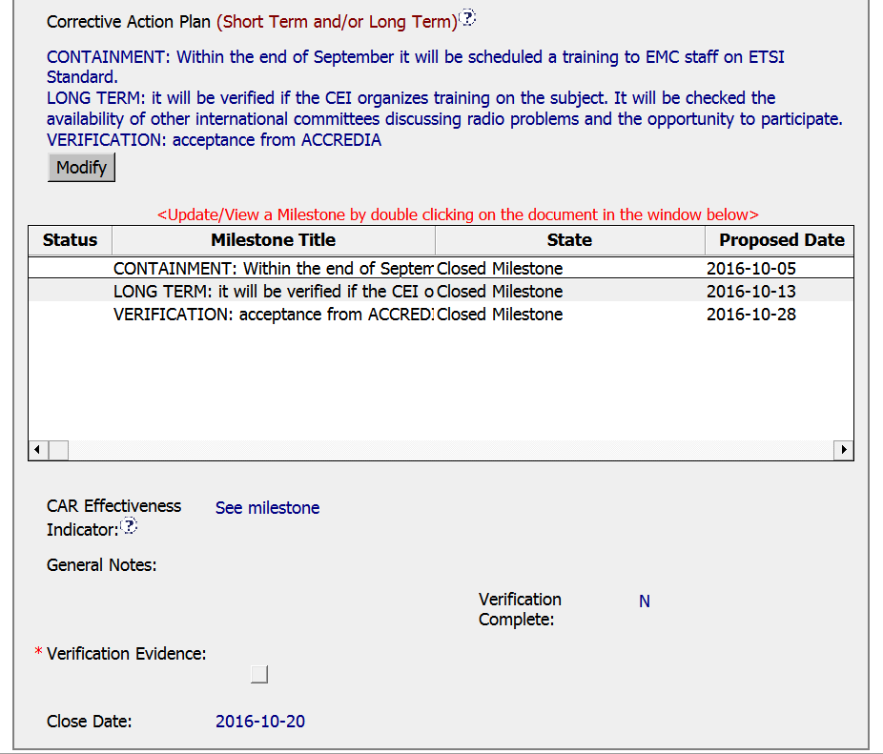
CAR 163916470
Good containment plan, including the supporting evidence of fulfilment as attached in milestone, and submitted before the due date.
For corrective action (only item), while it is understood to explore the training opportunity in the future when it is needed, however, it is lack of relevancy to the “Root Cause” being addressed.
Besides, the 2nd milestone is overdue to be responded.
For the Owner Verification, it may not be appropriate to set up as “Acceptance from Accredia” because it cannot demonstrate that the corrective action is effective.
Besides, it may not be appropriate set up the milestone expectation as “Provide ACCREDIA scope updated with ETSI Standard”.
Uncertain whether this CAR will be accepted as effective after verification although this CAR is still awaiting for verification.

Slide 11
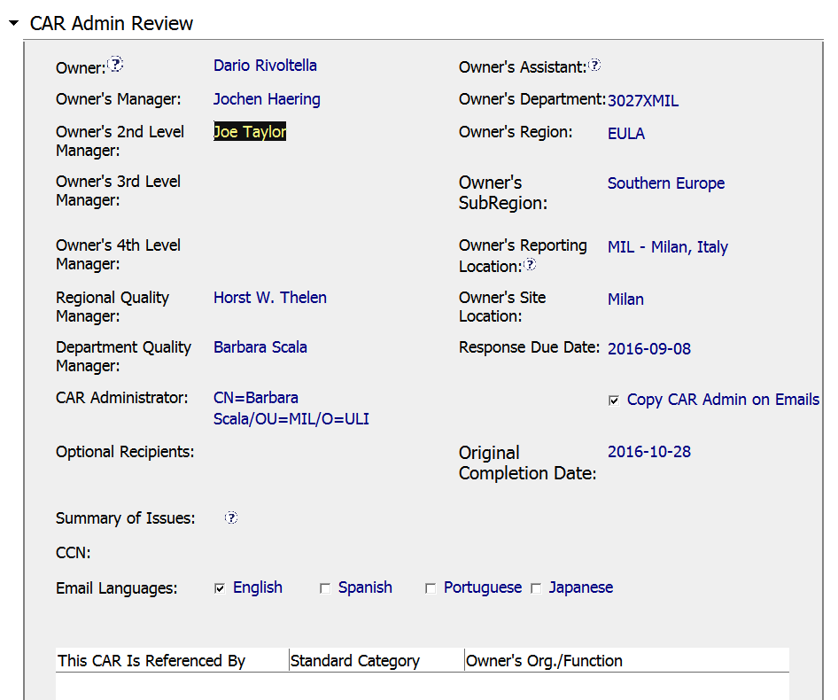
CAR 163916470
Suggestion: May be too early to skip the reporting line and jump to Mr. Joe Taylor.

Slide 12
CAR 163916470 – CBS Check
CBS Requirements | Excellent | Moderate | Need Improve | N/A
(C) Extensions are within requirement (<30 days, 3 or less) |  |  |  | ✓
(T) Most appropriate ‘category’, ‘type’, ‘geography’ are selected | ✓
(P) Facilitates the handling of disputed CARs |  | ✓
(T) Acts on CARs within required timeframe | ✓
(C) Analysis shows clear path to root cause and scope; stakeholders identified |  |  | ✓
(C) Root cause statement is succinct, reasonable, complete (Shows ‘N/A’ for observations) |  |  | ✓
(C) Corrective actions fix the objective evidence and other problems found; address entire root cause and scope. For observations, they do not go beyond fixing the objective evidence |  |  | ✓
(C) Milestones address containment & owner’s verification; completed per milestone expectations |  |  | ✓
(P) Verification per requirements |  |  | ✓
(L) Referenced communications are attached as needed | ✓
(C L) Evidence of communication for overdue/escalated CARs and other pertinent concerns |  |  | ✓
(P) Trains other CAR Champions |  |  |  | ✓

